Slide 1
Introduction to Public Cloud Networking
Fundamentals

Slide 2
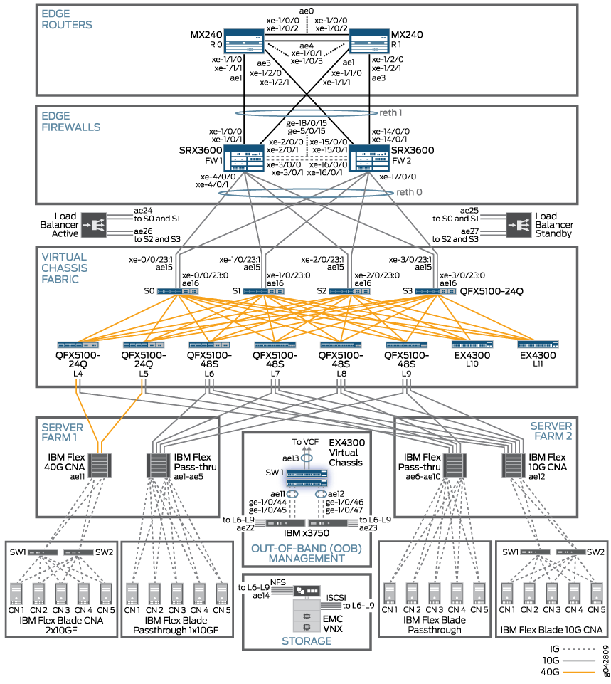
On-Prem Data Center Networks Control and Visibility
Notes:
This is a typical LLD of a DC and in order to build this high-performant, highly available, resilient infrastructure, you need time. The provisioning of all the networking services and components, generally speaking, requires time, efforts and indeed, is very slow. It involves so many hardware elements that you have to manage, such as cables, transceivers, switches, routers, racks, the real estate, physical security of the room and of the location that hosts your infrastructure, the power consumpation, the cooling system, without forgetting the hardware maintenance: such upgrade, replacement, monitoring and last but not least, the provisioning of the circuits.
But you have the thorough control and visibility of this infrastructure

Slide 3



On-Prem Infrastructure vs Public Cloud
Control
and Visibility
On-Prem Infrastructure
Data Center
Very slow to respond to DevOps
Hybrid Cloud
IaaS: Compute, Storage, and Networking abstracted
PaaS: Bring your own code SaaS: Pure consumption
Public Cloud
Multiple Clients
Hosted @ Cloud Service Providers (CSP)
Shared Infra
Abstractions and Agility
Notes:
The on-prem infra that we saw in the previous slide, does not provide adequate agility and abstraction, conversely it guarantees control and visibility: everything is inside your DC.
Don’t confuse, the on-prem infra with the private cloud. Private cloud is cloud computing that meets the 5 characteristics defined by the NIST (typical example of private cloud are: google Anthos, aws outposts and azure stack).
Vmware, hyper-v xenserver implementation are not necessarily private cloud. A lot of these platforms do have only private cloud-like features.
Then we have Hybrid environment (hybrid networking)= this term is used to refer to the idea of public cloud used together with existing on-premises infrastructure, in other words, the data-center based traditional infrastructure .
It’s not hybrid cloud if you just utilize a public environment such as aws together with your on-premises equipment.
Hybrid cloud is where you use both the private cloud (aws outsposts) and the public cloud
Then we have Public Cloud= it needs to first classify as a cloud environment, meeting the 5 essential characteristics of cloud computing defined by the NIST, and then it needs to be available to the general public.

Slide 4
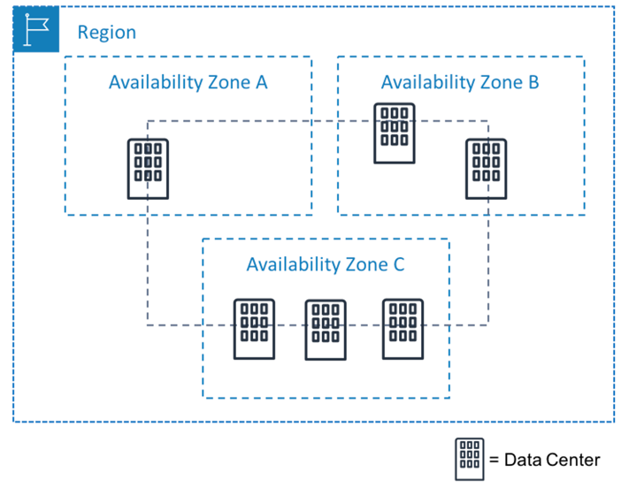
Public Cloud Basics
Public Cloud is just some one else’s data center.
Your data center is/was not perfect and had issues.
Data Centers of Cloud Service Providers are no different.
Except you have no visibility or control over it
Region
Data Centers are grouped in geographic regions to provide service availability.
Examples: US-West, US-East, Europe, Middle East, Australia etc.
Availability Zone (Data Center)
Distinct locations within a region that are engineered to be isolated from failures
Low-latency network connectivity to other Availability Zones in the same region
Not all CSPs have regions with multiple Availability Zones
Fault Domains / Availability Domains offer multiple racks / power lines for redundancy
AZs are randomized outside of an account
Notes:
A Public cloud is just somewhere else DC, we all can agree on this statement.
CSP comprises regions and Azs. The regions are set of data centers across the globe in order to provide availability. They are organized geographically.
The AZ can comprise one or multiple DC and they are deployed such that they can react to failures, like natural disasters.

Slide 5
Important Services Common to Every CSP
Function | Comments
Identity and Access Management | Who can do What to Which resource
Service | Compute, Storage, Network, Database
Resource | Specific instances that you can create (aka Constructs)
Virtual Data Center | Collection of resources that you can create within a geography
Dedicated Connectivity | Private path connectivity from on-prem to CSP region
Notes:
The common services and definitions available on each CSP
1) IAM= TRIPLE A concept: it is a service for authentication and authorization.
2) SERVICES: compute, storage, network, database
3) RESOURCES: instances or virtual machine where you run your app
4) VIRTUAL DATA CENTER: like VPC, VCN, VNET= collections of resources
5) DEDICATED CONNECTIVITY: private circuit from your DC towards the CSP through a supplier such megaport or equinix

Slide 6
Networking Areas to Consider in Cloud
Transit Networking
Hub-and-spoke Architecture
Intra-region, inter-region, inter-cloud
Connecting to Data Center over private links
Connecting to customers and one-off branches
Connecting to fleet of branches
Connecting to users
Connecting resources to Internet
Connecting to resources from Internet
Consistent routing, ensuring end-to-end network correctness
Notes:
Some things that need to be considered when talking about Networking in the cloud
Inter-cloud = MC
DC←→Cloud private links: speed and security
Customers, partners, one-off branches
Standardizing branches
Remote users and VPN
Resources → Internet like downloading updates and patches
Resources ← Internet like app servers, security
These are the areas that Aviatrix has built expertise on

Slide 7
Next: AWS Networking 101

